Slide 1
About Me
Ritesh Singh
Sun Certified java Professional
Oracle Certified Database Administrator
Certified Ethical Hacker
Certified EC-Council Instructor (CEI)

Slide 2
Course Overview
MySQL SELECT STATEMENT

Slide 3
Introduction to MySQL SELECT statement
The SELECT statement allows you to read data from one or more tables. To write a SELECT statement in MySQL, you follow this syntax:
SELECT select_list
FROM table_name;
Let’s look at each part of the statement.
First, you start the SELECT keyword. It is called a keyword because it has a special meaning in MySQL, in this case, SELECT instructs MySQL to retrieve data.

Slide 4
Next, you have space and then a list of columns or expressions that you want to show in the result.
Then, you have the FROM keyword, space and the name of the table.
Finally, you have a semicolon ; at the end of the statement.
The semicolon ( ;) is the statement delimiter. It specifies the end of a statement. If you have two or more statements, you use the semicolon ( ;) to separate them so that MySQL will execute each statement individually.

Slide 5

In the SELECT statement, the SELECT and FROM are keywords and written in capital letters. Basically, it is just about formating. The uppercase letters make the keywords stand out. Since SQL is not a case-sensitive language, you can write the keywords in lowercase e.g., select and from, the code will still run.
It is also important to note that the FROM keyword is on a new line. MySQL doesn’t require this. However, placing the FROM keyword on a new line will make the query easier to read and simpler to maintain.
When evaluating the SELECT statement, MySQL evaluates the FROM clause first and then the SELECT clause:

Slide 6
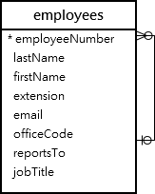
MySQL SELECT statement examples
We will use the table employees in the sample database to demonstrate how to use the SELECT statement:

Slide 7
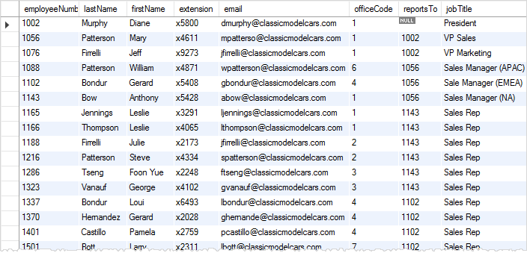
The table employees has eight columns: employee number, last name, first name, extension, email, office code, reports to, and job title. It also has many rows as shown in the following picture:

Slide 8

A) Using the MySQL SELECT statement to retrieve data from a single column example
The following example uses the SELECT statement to select the last names of all employees:
SELECT lastName
FROM employees;

Slide 9
The output of a SELECT statement is called results or a result set as it’s a set of data that results from a query.

Slide 10
B) Using the MySQL SELECT statement to query data from multiple columns example
The following example uses the SELECT statement to get the first name, last name, and job title of employees:
SELECT
lastname,
firstname,
jobtitle
FROM
employees;

Slide 11
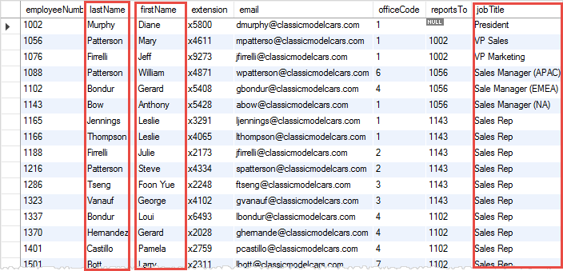
Even though the employees table has many columns, the SELECT statement just returns data of three columns of all rows in the table as highlighted in the following picture:

Slide 12
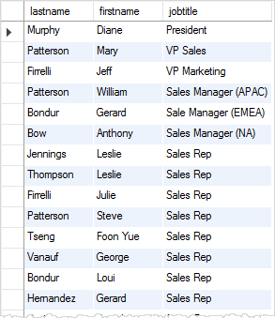
The following picture shows the result set:

Slide 13
C) Using the MySQL SELECT statement to retrieve data from all columns example
If you want to retrieve data from all the columns of the employees table, you can specify all the column names in the SELECT clause.
Or you just use the asterisk (*) shorthand as shown in the following query:
SELECT *
FROM employees;
The query returns data from all columns of the the employees table.

Slide 14
Notes about SELECT star
The SELECT * is often called “select star” or “select all” since you select all data from a table.
It is a good practice to use the SELECT * for the ad-hoc queries only. If you embed the SELECT statement in the code such as PHP, Java, Python, Node.js, you should explicitly specify the name of columns from which you want to get data because of the following reasons:

Slide 15
The SELECT * returns data from the columns that you may not use. It produces unnecessary I/O disk and network traffic between the MySQL database server and application.
When you explicitly specify the column names, the result set is predictable and easier to manage. However, if you use the SELECT * and someone changes the table by adding more columns, you will end up with a result set that is different from the one that you expected.
Using the SELECT * may expose sensitive information to unauthorized users.

Slide 16
Thank You
Please Subscribe My Channel
https://www.youtube.com/channel/UCYW3PWPOPn3qgxxjhUbXXXg?view_as=subscriber

